Slide 1
Problem Statement
Handling the increasing amount of online reviews is becoming more difficult for Intel in terms of manual customer feedback analysis.
The manual procedures used now take a lot of time and are prone to human error.
Making effective decisions is hampered by the absence of organized insights from customer reviews.

Slide 2
Unique Idea Brief (Solution)
Implementing in place a sentiment analysis system driven by AI.
Classifies and assesses user reviews of Intel products automatically.
Highlights important sentiment drivers and trends to offer actionable insights.

Slide 3
Features Offered
Automated Sentiment Analysis: This method evaluates the sentiments (positive, negative, and neutral) of reviews using natural language processing (NLP).
Real-time Data Processing: Constantly refreshed with fresh evaluations. Detailed Reporting: Produces in-depth analyses and graphics.
Alert System: Notifies relevant parties of significant shifts in sentiment.

Slide 4
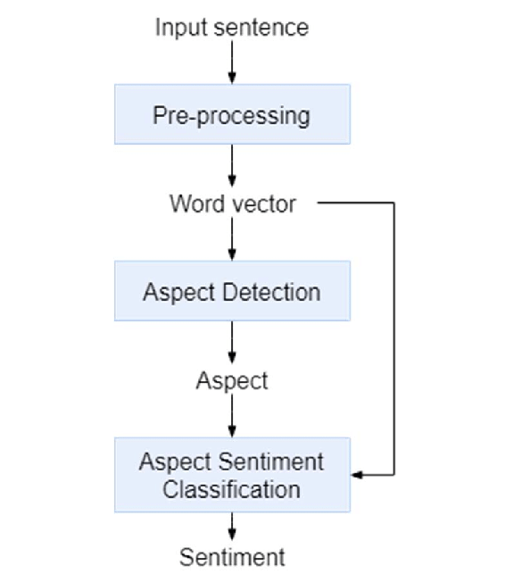
Process flow

Slide 5
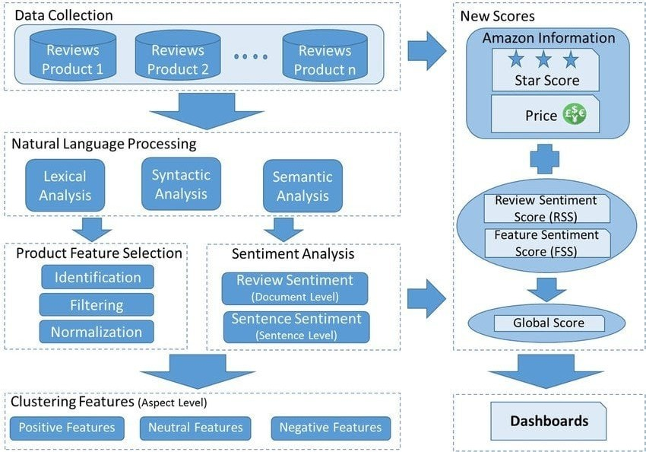
Architecture Diagram

Slide 6
Technologies used
Data Collection: Web Scraping tools, APIs
Preprocessing: Python, Pandas, NLTK etc
Sentiment Analysis: Machine Learning frameworks (TensorFlow, PyTorch), NLP libraries (BERT, GPT)

Slide 7
Conclusion
Understanding customer feedback from multiple platforms is made easier and more automated with the help of the Intel Product Online Review Sentiment Analysis system. By utilizing cutting-edge NLP and ML techniques, Intel is able to obtain insightful information that helps them make better business decisions, increase customer satisfaction, and improve product quality. By ensuring effectiveness, scalability, and continuous improvement, this system puts Intel in a position to meet customer needs and maintain its competitive edge in the market.

